Slide 1


Lab 7-1
Learning rate, Evaluation
With TF 1.0!
Sung Kim <hunkim+ml@gmail.com>
Code: https://github.com/hunkim/DeepLearningZeroToAll/

Slide 2

Call for comments
Please feel free to add comments directly on these slides
Other slides: https://goo.gl/jPtWNt
Picture from http://www.tssablog.org/archives/3280

Slide 3
Lab 7-1
Learning rate, Evaluation
With TF 1.0!
Sung Kim <hunkim+ml@gmail.com>
Code: https://github.com/hunkim/DeepLearningZeroToAll/

Slide 4

https://github.com/hunkim/DeepLearningZeroToAll/

Slide 5

Training and Test datasets
x_data = [[1, 2, 1], [1, 3, 2], [1, 3, 4], [1, 5, 5], [1, 7, 5], [1, 2, 5], [1, 6, 6], [1, 7, 7]]
y_data = [[0, 0, 1], [0, 0, 1], [0, 0, 1], [0, 1, 0], [0, 1, 0], [0, 1, 0], [1, 0, 0], [1, 0, 0]]
# Evaluation our model using this test dataset
x_test = [[2, 1, 1], [3, 1, 2], [3, 3, 4]]
y_test = [[0, 0, 1], [0, 0, 1], [0, 0, 1]]
https://github.com/hunkim/DeepLearningZeroToAll/blob/master/lab-07-1-learning_rate_and_evaluation.py

Slide 6
Training and Test datasets
X = tf.placeholder("float", [None, 3])
Y = tf.placeholder("float", [None, 3])
W = tf.Variable(tf.random_normal([3, 3]))
b = tf.Variable(tf.random_normal([3]))
hypothesis = tf.nn.softmax(tf.matmul(X, W)+b)
cost = tf.reduce_mean(-tf.reduce_sum(Y * tf.log(hypothesis), axis=1))
optimizer = tf.train.GradientDescentOptimizer(learning_rate=0.1).minimize(cost)
# Correct prediction Test model
prediction = tf.arg_max(hypothesis, 1)
is_correct = tf.equal(prediction, tf.arg_max(Y, 1))
accuracy = tf.reduce_mean(tf.cast(is_correct, tf.float32))
# Launch graph
with tf.Session() as sess:
# Initialize TensorFlow variables
sess.run(tf.global_variables_initializer())
for step in range(201):
cost_val, W_val, _ = sess.run([cost, W, optimizer],
feed_dict={X: x_data, Y: y_data})
print(step, cost_val, W_val)
# predict
print("Prediction:", sess.run(prediction, feed_dict={X: x_test}))
# Calculate the accuracy
print("Accuracy: ", sess.run(accuracy, feed_dict={X: x_test, Y: y_test}))
199 0.672261 [[-1.15377033 0.28146935 1.13632679]
[ 0.37484586 0.18958236 0.33544877]
[-0.35609841 -0.43973011 -1.25604188]]
200 0.670909 [[-1.15885413 0.28058422 1.14229572]
[ 0.37609792 0.19073224 0.33304682]
[-0.35536593 -0.44033223 -1.2561723 ]]
Prediction: [2 2 2]
Accuracy: 1.0
https://github.com/hunkim/DeepLearningZeroToAll/blob/master/lab-07-1-learning_rate_and_evaluation.py

Slide 7
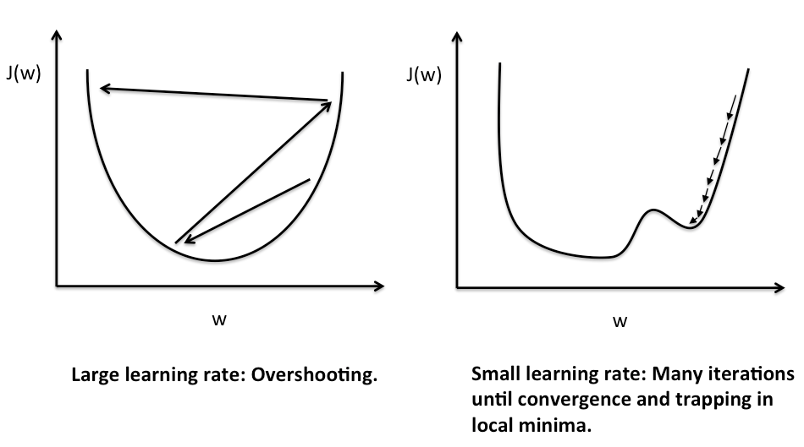
Learning rate: NaN!
http://sebastianraschka.com/Articles/2015_singlelayer_neurons.html

Slide 8
Big learning rate
X = tf.placeholder("float", [None, 3])
Y = tf.placeholder("float", [None, 3])
W = tf.Variable(tf.random_normal([3, 3]))
b = tf.Variable(tf.random_normal([3]))
hypothesis = tf.nn.softmax(tf.matmul(X, W)+b)
cost = tf.reduce_mean(-tf.reduce_sum(Y * tf.log(hypothesis), axis=1))
optimizer = tf.train.GradientDescentOptimizer
(learning_rate=1.5).minimize(cost)
# Correct prediction Test model
prediction = tf.arg_max(hypothesis, 1)
is_correct = tf.equal(prediction, tf.arg_max(Y, 1))
accuracy = tf.reduce_mean(tf.cast(is_correct, tf.float32))
# Launch graph
with tf.Session() as sess:
# Initialize TensorFlow variables
sess.run(tf.global_variables_initializer())
for step in range(201):
cost_val, W_val, _ = sess.run([cost, W, optimizer],
feed_dict={X: x_data, Y: y_data})
print(step, cost_val, W_val)
# predict
print("Prediction:", sess.run(prediction, feed_dict={X: x_test}))
# Calculate the accuracy
print("Accuracy: ", sess.run(accuracy, feed_dict={X: x_test, Y: y_test}))
2 27.2798 [[ 0.44451016 0.85699677 -1.03748143]
[ 0.48429942 0.98872018 -0.57314301]
[ 1.52989244 1.16229868 -4.74406147]]
3 8.668 [[ 0.12396193 0.61504567 -0.47498202]
[ 0.22003263 -0.2470119 0.9268558 ]
[ 0.96035379 0.41933775 -3.43156195]]
4 5.77111 [[-0.9524312 1.13037777 0.08607888]
[-3.78651619 2.26245379 2.42393875]
[-3.07170963 3.14037919 -2.12054014]]
5 inf [[ nan nan nan]
[ nan nan nan]
[ nan nan nan]]
6 nan [[ nan nan nan]
[ nan nan nan]
[ nan nan nan]]
...
Prediction: [0 0 0]
Accuracy: 0.0
https://github.com/hunkim/DeepLearningZeroToAll/blob/master/lab-07-1-learning_rate_and_evaluation.py

Slide 9
Small learning rate
X = tf.placeholder("float", [None, 3])
Y = tf.placeholder("float", [None, 3])
W = tf.Variable(tf.random_normal([3, 3]))
b = tf.Variable(tf.random_normal([3]))
hypothesis = tf.nn.softmax(tf.matmul(X, W)+b)
cost = tf.reduce_mean(-tf.reduce_sum(Y * tf.log(hypothesis), axis=1))
optimizer = tf.train.GradientDescentOptimizer
(learning_rate=1e-10).minimize(cost)
# Correct prediction Test model
prediction = tf.arg_max(hypothesis, 1)
is_correct = tf.equal(prediction, tf.arg_max(Y, 1))
accuracy = tf.reduce_mean(tf.cast(is_correct, tf.float32))
# Launch graph
with tf.Session() as sess:
# Initialize TensorFlow variables
sess.run(tf.global_variables_initializer())
for step in range(201):
cost_val, W_val, _ = sess.run([cost, W, optimizer],
feed_dict={X: x_data, Y: y_data})
print(step, cost_val, W_val)
# predict
print("Prediction:", sess.run(prediction, feed_dict={X: x_test}))
# Calculate the accuracy
print("Accuracy: ", sess.run(accuracy, feed_dict={X: x_test, Y: y_test}))
0 5.73203 [[ 0.80269563 0.67861295 -1.21728313]
[-0.3051686 -0.3032113 1.50825703]
[ 0.75722361 -0.7008909 -2.10820389]]
1 5.73203 [[ 0.80269563 0.67861295 -1.21728313]
[-0.3051686 -0.3032113 1.50825703]
[ 0.75722361 -0.7008909 -2.10820389]]
...
198 5.73203 [[ 0.80269563 0.67861295 -1.21728313]
[-0.3051686 -0.3032113 1.50825703]
[ 0.75722361 -0.7008909 -2.10820389]]
199 5.73203 [[ 0.80269563 0.67861295 -1.21728313]
[-0.3051686 -0.3032113 1.50825703]
[ 0.75722361 -0.7008909 -2.10820389]]
200 5.73203 [[ 0.80269563 0.67861295 -1.21728313]
[-0.3051686 -0.3032113 1.50825703]
[ 0.75722361 -0.7008909 -2.10820389]]
Prediction: [0 0 0]
Accuracy: 0.0
https://github.com/hunkim/DeepLearningZeroToAll/blob/master/lab-07-1-learning_rate_and_evaluation.py

Slide 10
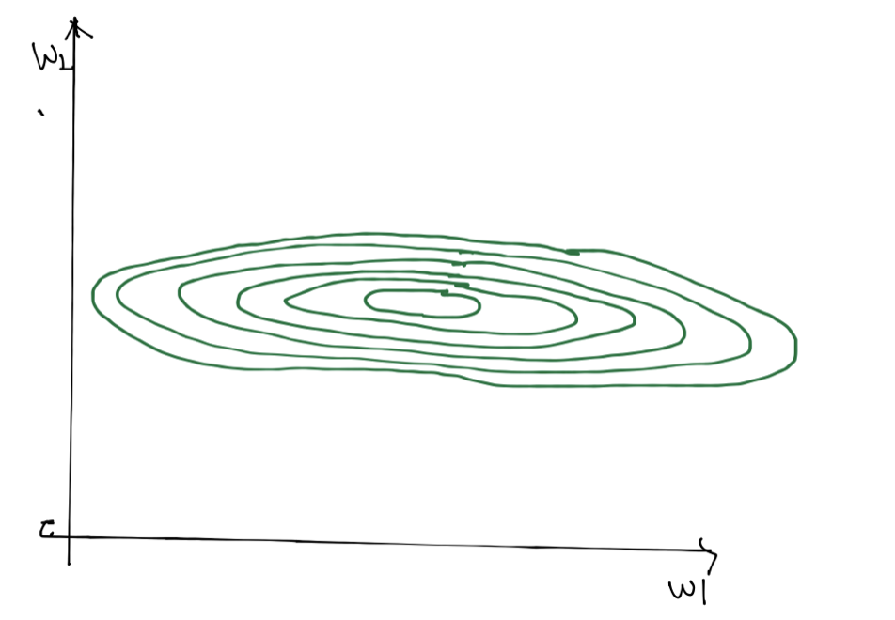
Non-normalized inputs
xy = np.array([[828.659973, 833.450012, 908100, 828.349976, 831.659973],
[823.02002, 828.070007, 1828100, 821.655029, 828.070007],
[819.929993, 824.400024, 1438100, 818.97998, 824.159973],
[816, 820.958984, 1008100, 815.48999, 819.23999],
[819.359985, 823, 1188100, 818.469971, 818.97998],
[819, 823, 1198100, 816, 820.450012],
[811.700012, 815.25, 1098100, 809.780029, 813.669983],
[809.51001, 816.659973, 1398100, 804.539978, 809.559998]])
https://github.com/hunkim/DeepLearningZeroToAll/blob/master/lab-07-2-linear_regression_without_min_max.py

Slide 11
Non-normalized inputs
xy=...
x_data = xy[:, 0:-1]
y_data = xy[:, [-1]]
# placeholders for a tensor that will be always fed.
X = tf.placeholder(tf.float32, shape=[None, 4])
Y = tf.placeholder(tf.float32, shape=[None, 1])
W = tf.Variable(tf.random_normal([4, 1]), name='weight')
b = tf.Variable(tf.random_normal([1]), name='bias')
hypothesis = tf.matmul(X, W) + b
cost = tf.reduce_mean(tf.square(hypothesis - Y))
# Minimize
optimizer = tf.train.GradientDescentOptimizer(learning_rate=1e-5)
train = optimizer.minimize(cost)
sess = tf.Session()
sess.run(tf.global_variables_initializer())
for step in range(2001):
cost_val, hy_val, _ = sess.run(
[cost, hypothesis, train], feed_dict={X: x_data, Y: y_data})
print(step, "Cost: ", cost_val, "\nPrediction:\n", hy_val)
5 Cost: inf
Prediction:
[[ inf]
[ inf]
[ inf]
...
6 Cost: nan
Prediction:
[[ nan]
[ nan]
[ nan]
...
https://github.com/hunkim/DeepLearningZeroToAll/blob/master/lab-07-2-linear_regression_without_min_max.py

Slide 12
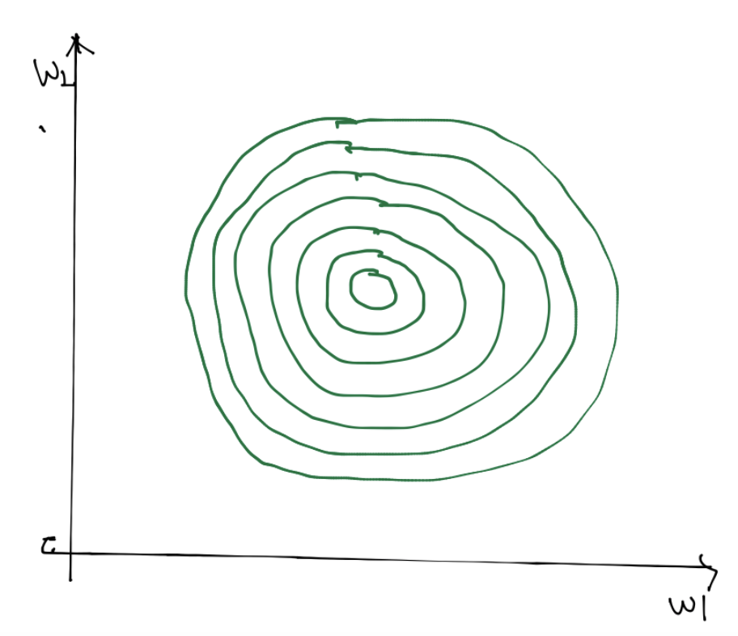
Normalized inputs (min-max scale)
xy = np.array([[828.659973, 833.450012, 908100, 828.349976, 831.659973],
[823.02002, 828.070007, 1828100, 821.655029, 828.070007],
[819.929993, 824.400024, 1438100, 818.97998, 824.159973],
[816, 820.958984, 1008100, 815.48999, 819.23999],
[819.359985, 823, 1188100, 818.469971, 818.97998],
[819, 823, 1198100, 816, 820.450012],
[811.700012, 815.25, 1098100, 809.780029, 813.669983],
[809.51001, 816.659973, 1398100, 804.539978, 809.559998]])
xy = MinMaxScaler(xy)
print(xy)
[[ 0.99999999 0.99999999 0. 1. 1. ]
[ 0.70548491 0.70439552 1. 0.71881782 0.83755791]
[ 0.54412549 0.50274824 0.57608696 0.606468 0.6606331 ]
[ 0.33890353 0.31368023 0.10869565 0.45989134 0.43800918]
[ 0.51436 0.42582389 0.30434783 0.58504805 0.42624401]
[ 0.49556179 0.42582389 0.31521739 0.48131134 0.49276137]
[ 0.11436064 0. 0.20652174 0.22007776 0.18597238]
[ 0. 0.07747099 0.5326087 0. 0. ]]
https://github.com/hunkim/DeepLearningZeroToAll/blob/master/lab-07-3-linear_regression_min_max.py

Slide 13
Normalized inputs
xy=...
x_data = xy[:, 0:-1]
y_data = xy[:, [-1]]
# placeholders for a tensor that will be always fed.
X = tf.placeholder(tf.float32, shape=[None, 4])
Y = tf.placeholder(tf.float32, shape=[None, 1])
W = tf.Variable(tf.random_normal([4, 1]), name='weight')
b = tf.Variable(tf.random_normal([1]), name='bias')
hypothesis = tf.matmul(X, W) + b
cost = tf.reduce_mean(tf.square(hypothesis - Y))
# Minimize
optimizer = tf.train.GradientDescentOptimizer(learning_rate=1e-5)
train = optimizer.minimize(cost)
sess = tf.Session()
sess.run(tf.global_variables_initializer())
for step in range(2001):
cost_val, hy_val, _ = sess.run(
[cost, hypothesis, train], feed_dict={X: x_data, Y: y_data})
print(step, "Cost: ", cost_val, "\nPrediction:\n", hy_val)
Prediction:
[[ 1.63450289]
[ 0.06628087]
[ 0.35014752]
[ 0.67070574]
[ 0.61131608]
[ 0.61466062]
[ 0.23175186]
[-0.13716528]]
https://github.com/hunkim/DeepLearningZeroToAll/blob/master/lab-07-3-linear_regression_min_max.py

Slide 14
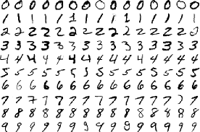
Lab 7-2
MNIST data
With TF 1.0!
Sung Kim <hunkim+ml@gmail.com>
Code: https://github.com/hunkim/DeepLearningZeroToAll/

Slide 15
https://github.com/hunkim/DeepLearningZeroToAll/

Slide 16
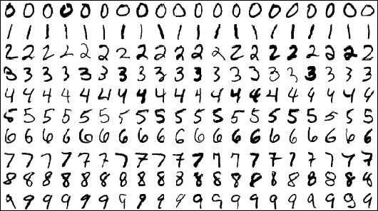
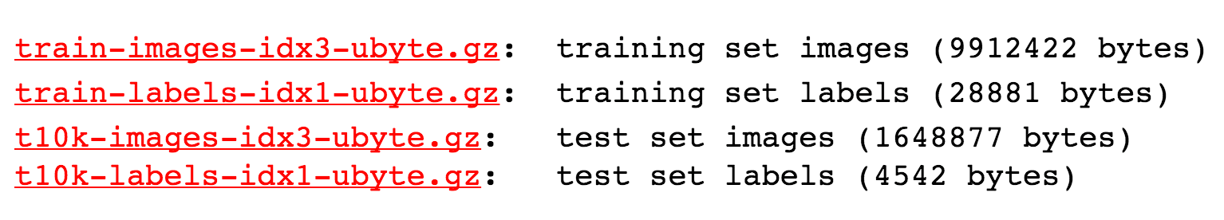
MNIST Dataset
http://yann.lecun.com/exdb/mnist/

Slide 17
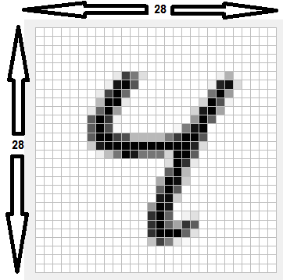
28x28x1 image
# MNIST data image of shape 28 * 28 = 784
X = tf.placeholder(tf.float32, [None, 784])
# 0 - 9 digits recognition = 10 classes
Y = tf.placeholder(tf.float32, [None, nb_classes])
http://derindelimavi.blogspot.hk/2015/04/mnist-el-yazs-rakam-veri-seti.html

Slide 18
MNIST Dataset
from tensorflow.examples.tutorials.mnist import input_data
# Check out https://www.tensorflow.org/get_started/mnist/beginners for
# more information about the mnist dataset
mnist = input_data.read_data_sets("MNIST_data/", one_hot=True)
…
batch_xs, batch_ys = mnist.train.next_batch(100)
…
print("Accuracy: ", accuracy.eval(session=sess,
feed_dict={X: mnist.test.images, Y: mnist.test.labels}))
https://github.com/hunkim/DeepLearningZeroToAll/blob/master/lab-07-4-mnist_introduction.py

Slide 19
Reading data and set variables
from tensorflow.examples.tutorials.mnist import input_data
# Check out https://www.tensorflow.org/get_started/mnist/beginners for
# more information about the mnist dataset
mnist = input_data.read_data_sets("MNIST_data/", one_hot=True)
nb_classes = 10
# MNIST data image of shape 28 * 28 = 784
X = tf.placeholder(tf.float32, [None, 784])
# 0 - 9 digits recognition = 10 classes
Y = tf.placeholder(tf.float32, [None, nb_classes])
W = tf.Variable(tf.random_normal([784, nb_classes]))
b = tf.Variable(tf.random_normal([nb_classes]))
https://github.com/hunkim/DeepLearningZeroToAll/blob/master/lab-07-4-mnist_introduction.py

Slide 20
Softmax!
# Hypothesis (using softmax)
hypothesis = tf.nn.softmax(tf.matmul(X, W) + b)
cost = tf.reduce_mean(-tf.reduce_sum(Y * tf.log(hypothesis), axis=1))
optimizer = tf.train.GradientDescentOptimizer(learning_rate=0.1).minimize(cost)
# Test model
is_correct = tf.equal(tf.arg_max(hypothesis, 1), tf.arg_max(Y, 1))
# Calculate accuracy
accuracy = tf.reduce_mean(tf.cast(is_correct, tf.float32))
https://github.com/hunkim/DeepLearningZeroToAll/blob/master/lab-07-4-mnist_introduction.py

Slide 21
Training epoch/batch
# parameters
training_epochs = 15
batch_size = 100
with tf.Session() as sess:
# Initialize TensorFlow variables
sess.run(tf.global_variables_initializer())
# Training cycle
for epoch in range(training_epochs):
avg_cost = 0
total_batch = int(mnist.train.num_examples / batch_size)
for i in range(total_batch):
batch_xs, batch_ys = mnist.train.next_batch(batch_size)
c, _ = sess.run([cost, optimizer], feed_dict={X: batch_xs, Y: batch_ys})
avg_cost += c / total_batch
print('Epoch:', '%04d' % (epoch + 1), 'cost =', '{:.9f}'.format(avg_cost))
https://github.com/hunkim/DeepLearningZeroToAll/blob/master/lab-07-4-mnist_introduction.py

Slide 22
Training epoch/batch
In the neural network terminology:
one epoch = one forward pass and one backward pass of all the training examples
batch size = the number of training examples in one forward/backward pass. The higher the batch size, the more memory space you'll need.
number of iterations = number of passes, each pass using [batch size] number of examples. To be clear, one pass = one forward pass + one backward pass (we do not count the forward pass and backward pass as two different passes).
Example: if you have 1000 training examples, and your batch size is 500, then it will take 2 iterations to complete 1 epoch.
http://stackoverflow.com/questions/4752626/epoch-vs-iteration-when-training-neural-networks

Slide 23
Training epoch/batch
# parameters
training_epochs = 15
batch_size = 100
with tf.Session() as sess:
# Initialize TensorFlow variables
sess.run(tf.global_variables_initializer())
# Training cycle
for epoch in range(training_epochs):
avg_cost = 0
total_batch = int(mnist.train.num_examples / batch_size)
for i in range(total_batch):
batch_xs, batch_ys = mnist.train.next_batch(batch_size)
c, _ = sess.run([cost, optimizer], feed_dict={X: batch_xs, Y: batch_ys})
avg_cost += c / total_batch
print('Epoch:', '%04d' % (epoch + 1), 'cost =', '{:.9f}'.format(avg_cost))
https://github.com/hunkim/DeepLearningZeroToAll/blob/master/lab-07-4-mnist_introduction.py

Slide 24
Report results on test dataset
# Test the model using test sets
print("Accuracy: ", accuracy.eval(session=sess,
feed_dict={X: mnist.test.images, Y: mnist.test.labels}))
https://github.com/hunkim/DeepLearningZeroToAll/blob/master/lab-07-4-mnist_introduction.py

Slide 25
hypothesis = tf.nn.softmax(tf.matmul(X, W) + b)
cost = tf.reduce_mean(-tf.reduce_sum(Y * tf.log(hypothesis), axis=1))
optimizer = tf.train.GradientDescentOptimizer(learning_rate=0.1).minimize(cost)
is_correct = tf.equal(tf.arg_max(hypothesis, 1), tf.arg_max(Y, 1))
accuracy = tf.reduce_mean(tf.cast(is_correct, tf.float32))
# parameters
training_epochs = 15
batch_size = 100
with tf.Session() as sess:
# Initialize TensorFlow variables
sess.run(tf.global_variables_initializer())
# Training cycle
for epoch in range(training_epochs):
avg_cost = 0
total_batch = int(mnist.train.num_examples / batch_size)
for i in range(total_batch):
batch_xs, batch_ys = mnist.train.next_batch(batch_size)
c, _ = sess.run([cost, optimizer],
feed_dict={X: batch_xs, Y: batch_ys})
avg_cost += c / total_batch
print('Epoch:', '%04d' % (epoch + 1),
'cost =', '{:.9f}'.format(avg_cost))
Epoch: 0001 cost = 2.868104637
Epoch: 0002 cost = 1.134684615
Epoch: 0003 cost = 0.908220728
Epoch: 0004 cost = 0.794199896
Epoch: 0005 cost = 0.721815854
Epoch: 0006 cost = 0.670184430
Epoch: 0007 cost = 0.630576546
Epoch: 0008 cost = 0.598888191
Epoch: 0009 cost = 0.573027079
Epoch: 0010 cost = 0.550497213
Epoch: 0011 cost = 0.532001859
Epoch: 0012 cost = 0.515517795
Epoch: 0013 cost = 0.501175288
Epoch: 0014 cost = 0.488425370
Epoch: 0015 cost = 0.476968593
Learning finished
Accuracy: 0.888
https://github.com/hunkim/DeepLearningZeroToAll/blob/master/lab-07-4-mnist_introduction.py

Slide 26
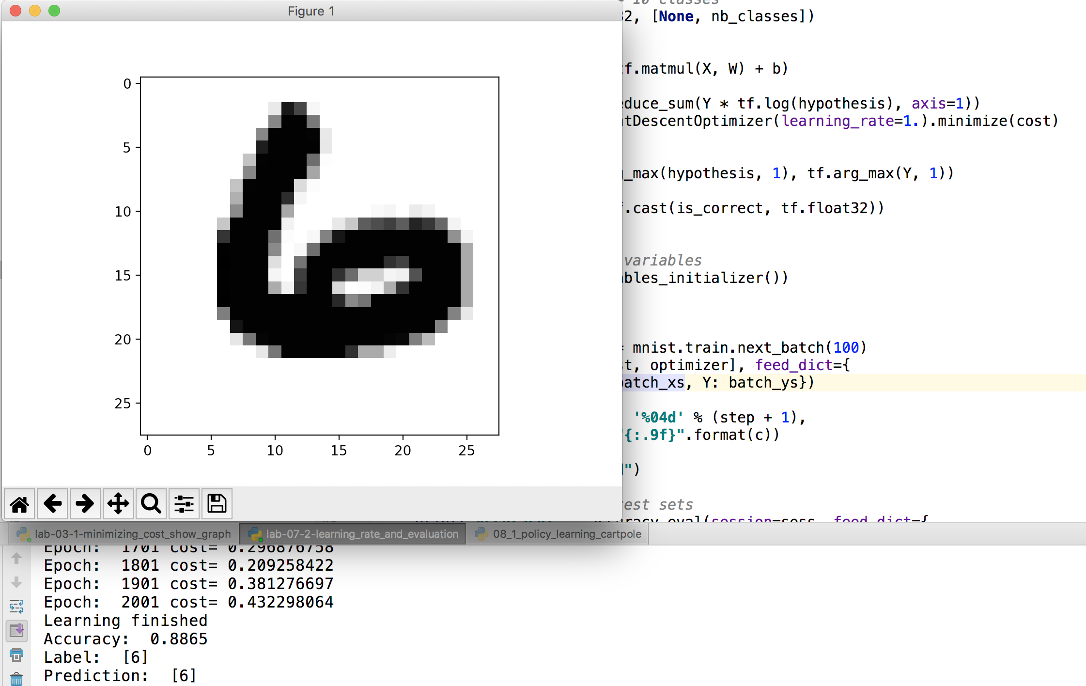
Sample image show and prediction
import matplotlib.pyplot as plt
import random
# Get one and predict
r = random.randint(0, mnist.test.num_examples - 1)
print("Label:", sess.run(tf.argmax(mnist.test.labels[r:r+1], 1)))
print("Prediction:", sess.run(tf.argmax(hypothesis, 1),
feed_dict={X: mnist.test.images[r:r + 1]}))
plt.imshow(mnist.test.images[r:r + 1].
reshape(28, 28), cmap='Greys', interpolation='nearest')
plt.show()
https://github.com/hunkim/DeepLearningZeroToAll/blob/master/lab-07-4-mnist_introduction.py

Slide 27
Lab 8
Tensor Manipulation
Sung Kim <hunkim+ml@gmail.com>

